Slide 1
REGISTRATION GUIDE
GCOM 2024

Slide 2
TO REGISTER
Enter
Enter the website www.gcom.imyos.org
Click on
Click on ”Registration & Submission”
Click on
Click on “Register & Submit here”
Read
Read the information and click on “Register now”

Slide 3
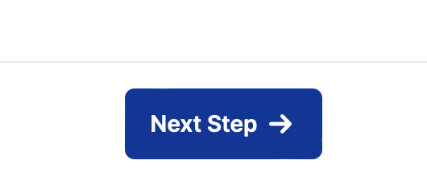
Register yourself or another person
Choose which category to register in.
Click on the circel and then →

Slide 4
Personal info
Fill in your personal information and create a password.
Remember your password as you can log in to your
registration area when you want.

Slide 5
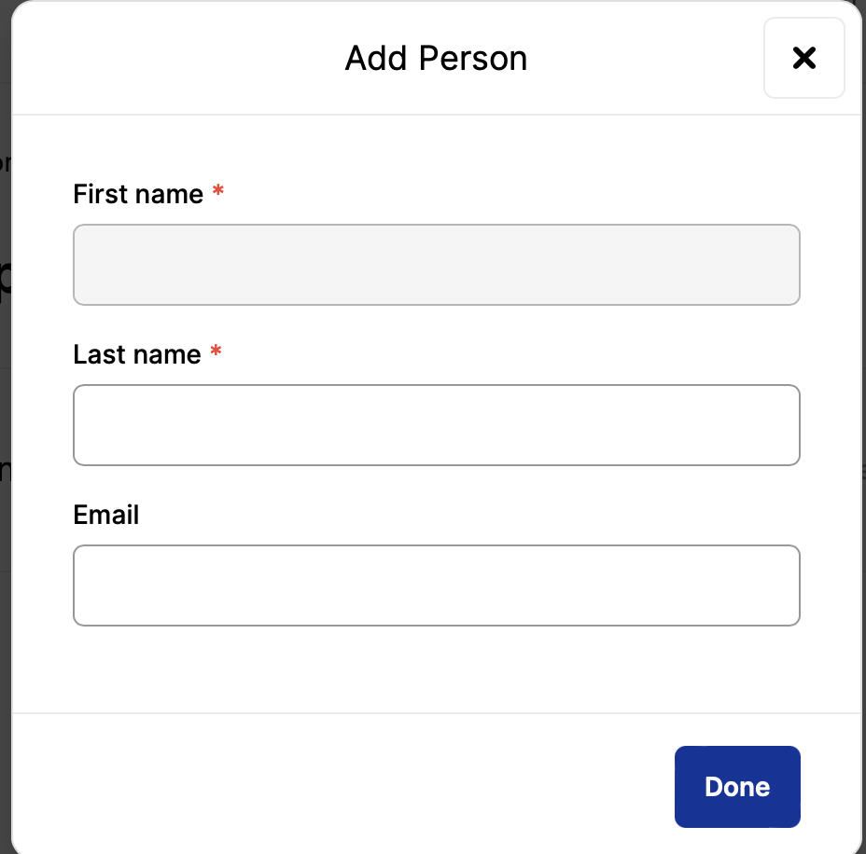
Want to bring someone – Accompanying person
You can bring someone who will not follow the conference but come with you just add a person and fill in their personal data.

Slide 6
SUBMIT AN ABSTRACT
Click here if you would like to submit an abstract 2 abstracts pr. registered participants.

Slide 7
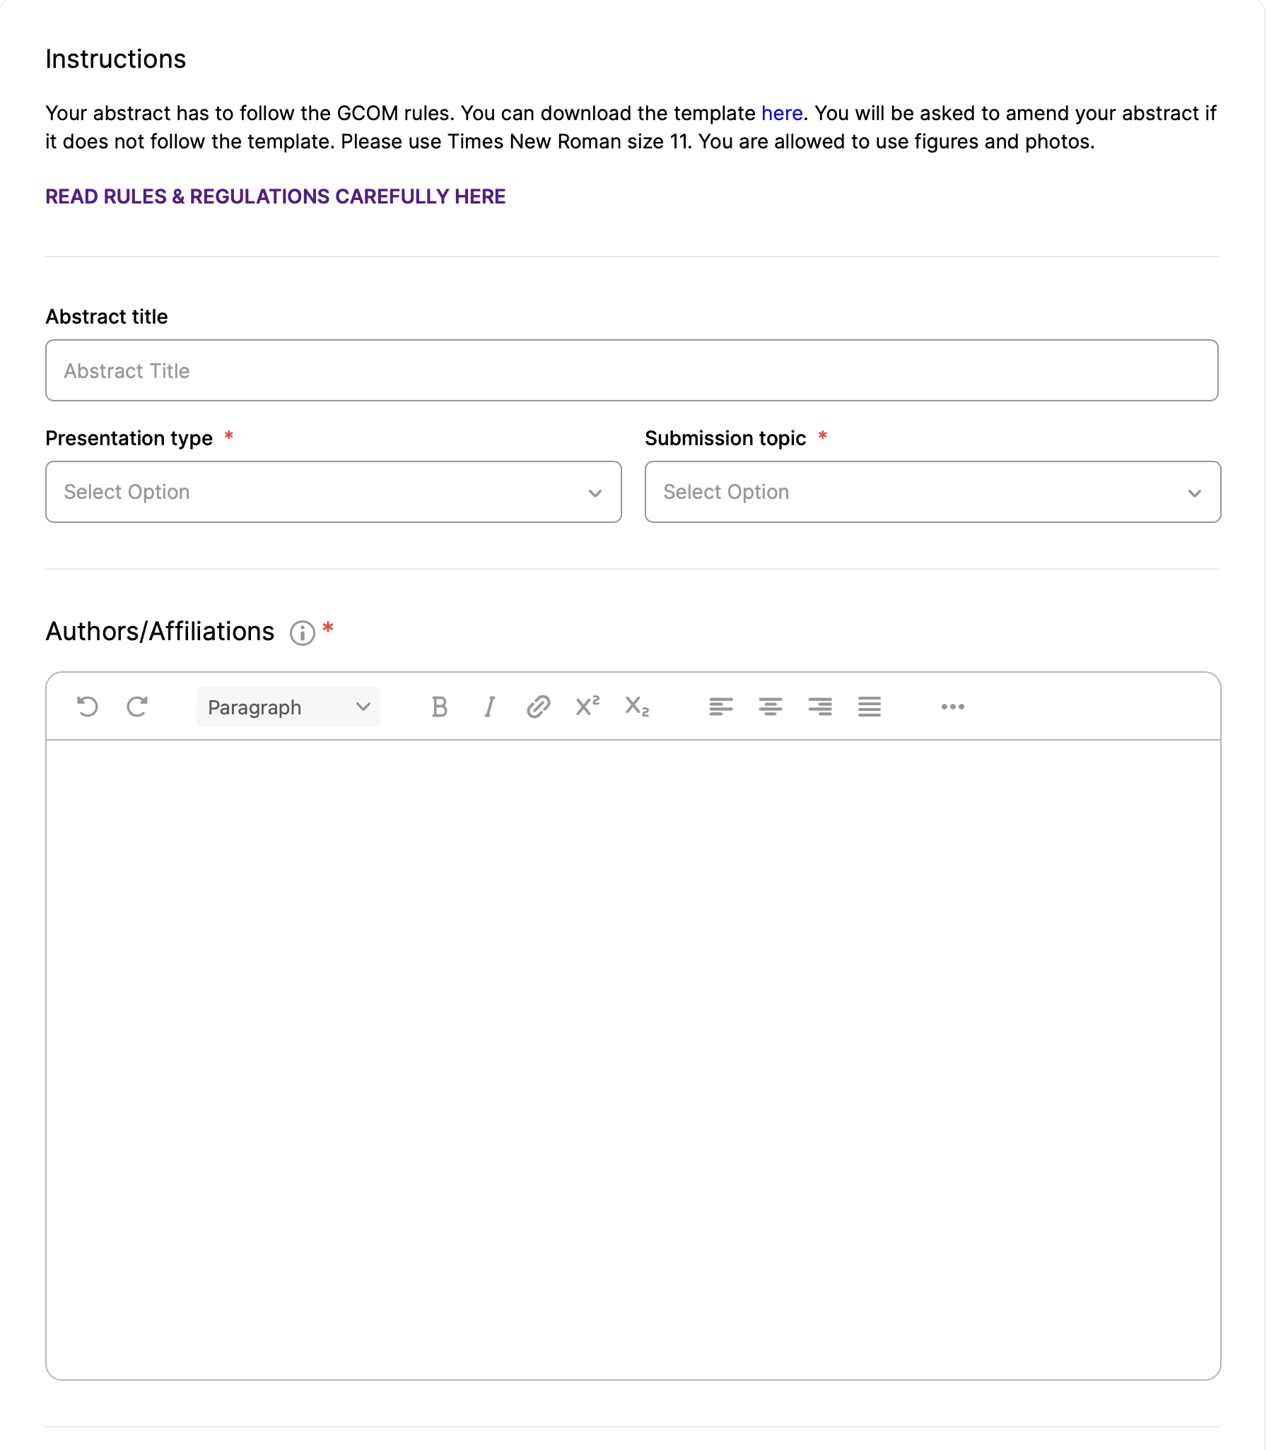
Abstract submission
Read the rules & regulations carfully clicking on the link here
Fill in your abstract title and presentation preference,
then choose a topic
Fill in all the authors with affiliations remember the rules!

Slide 8
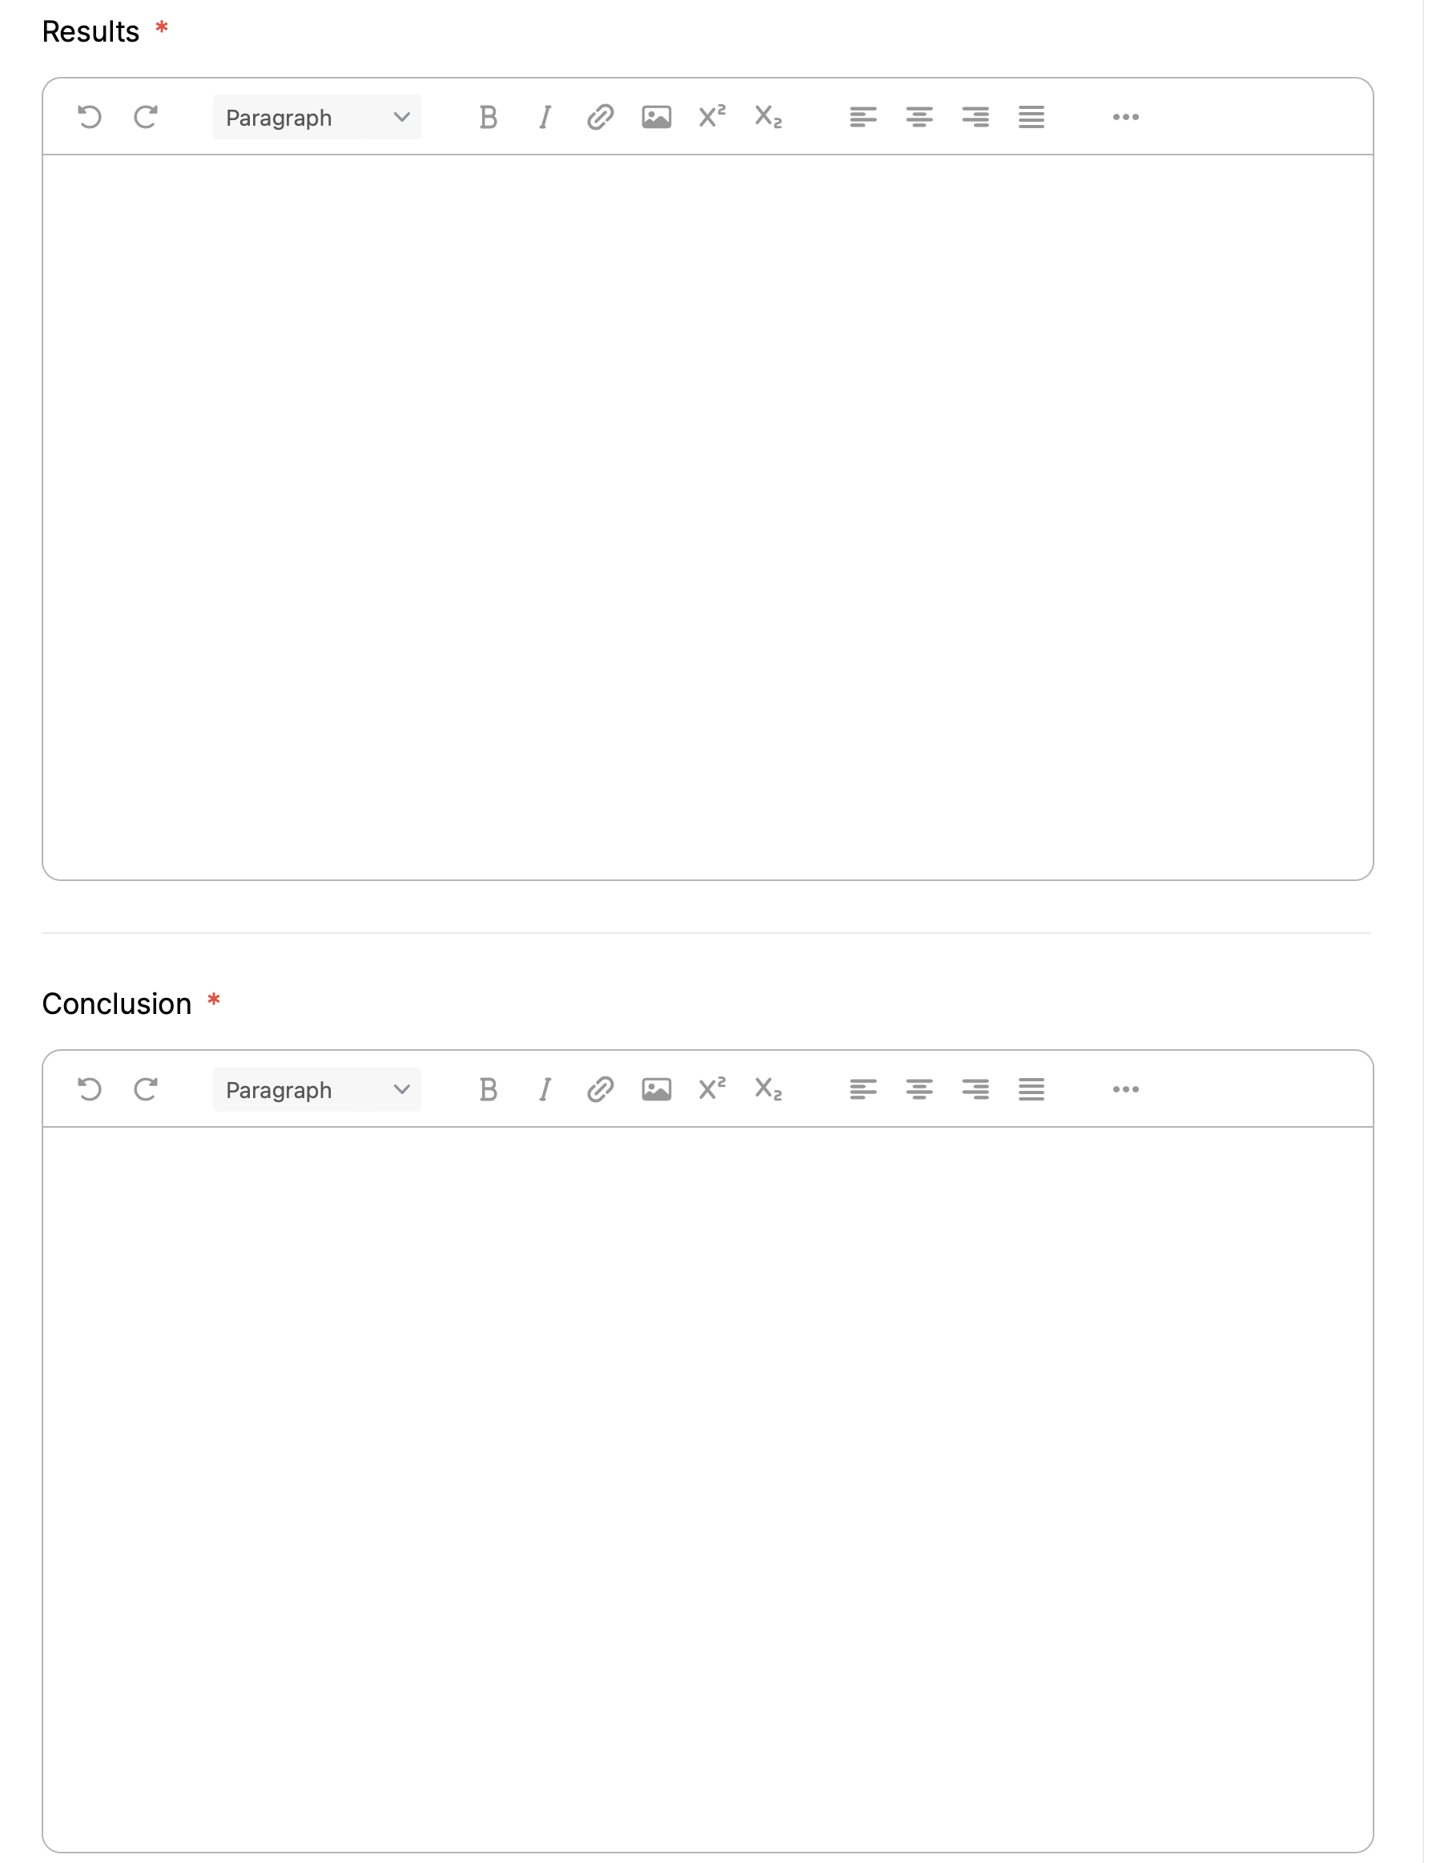
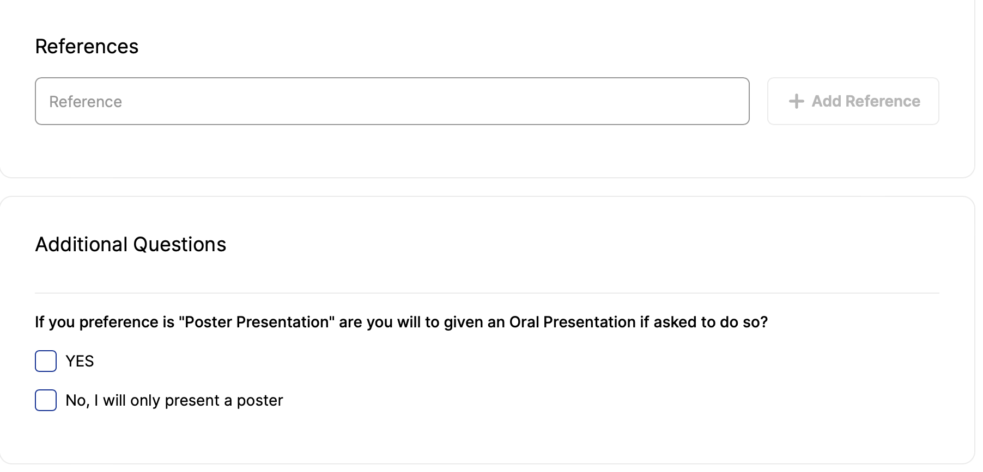
Write your abstract
Fill in the different areas with your abstract text.
If you have references, add them!
If you choose preference ”poster” you might be asked to present an oral based on your abstract. Let us know if you agree to this.
Remember it is just a preference – you might choose “oral”, but your outcome will be “poster”.

Slide 9
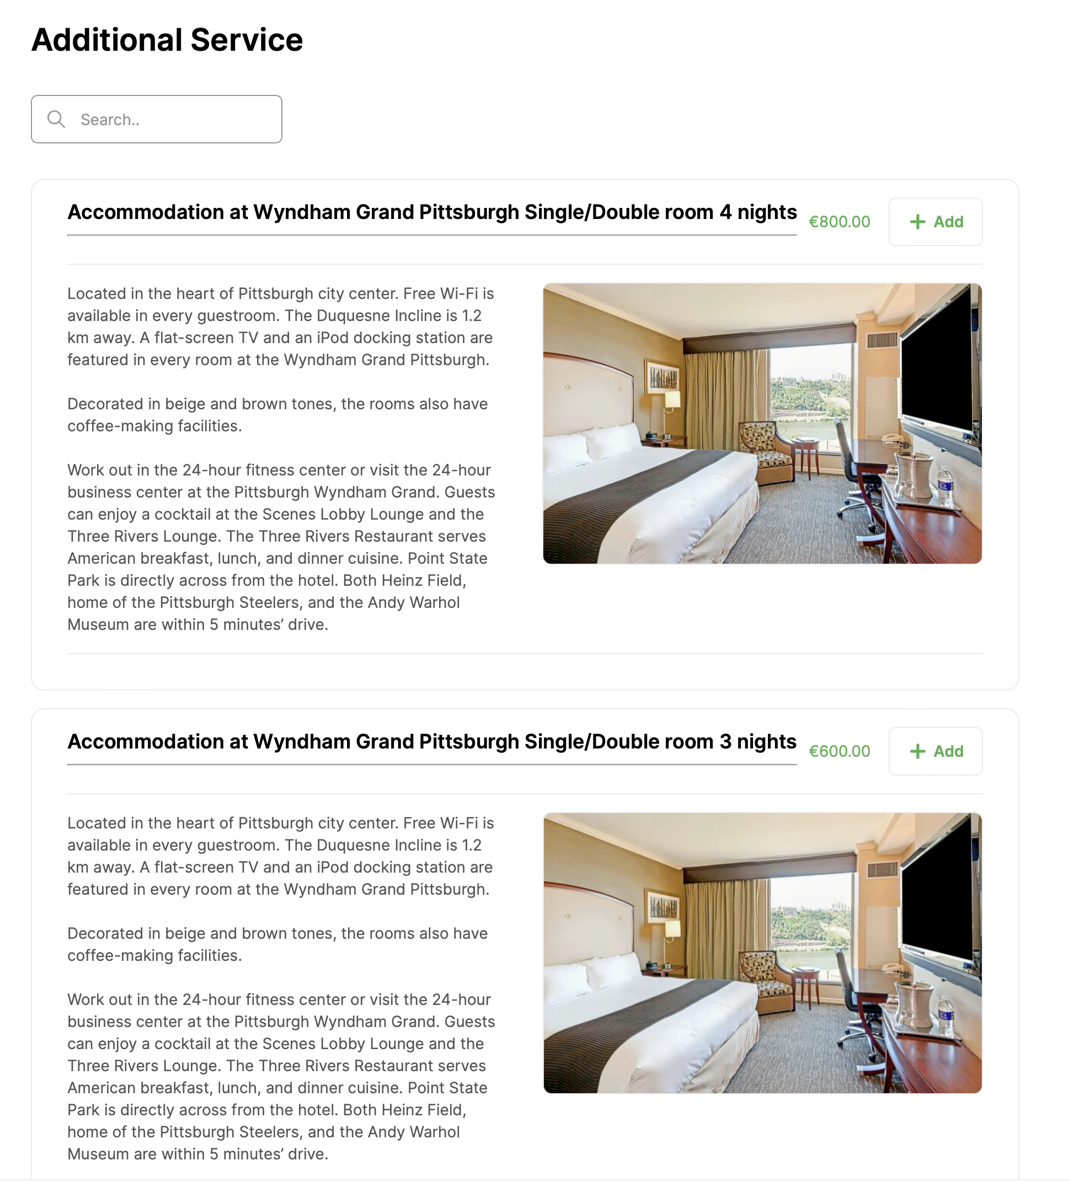
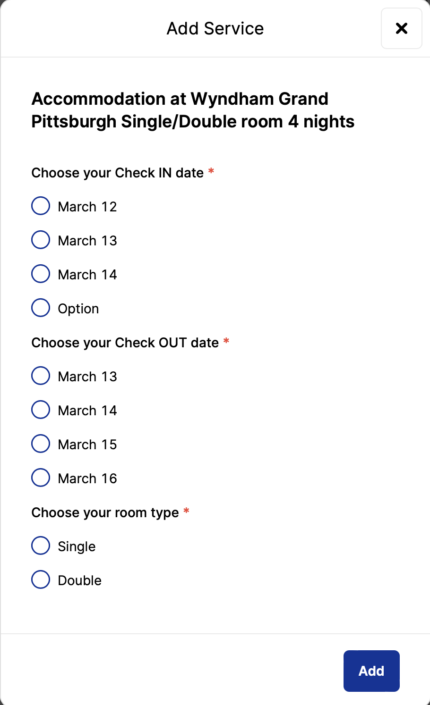
Need accommodation?
Click on the “+ Add” in the up in the right corner for the accommodation you would like. The hotel is the same it is only the dates which changes.
You will then be asked to choose your accommodation dates and room type

Slide 10
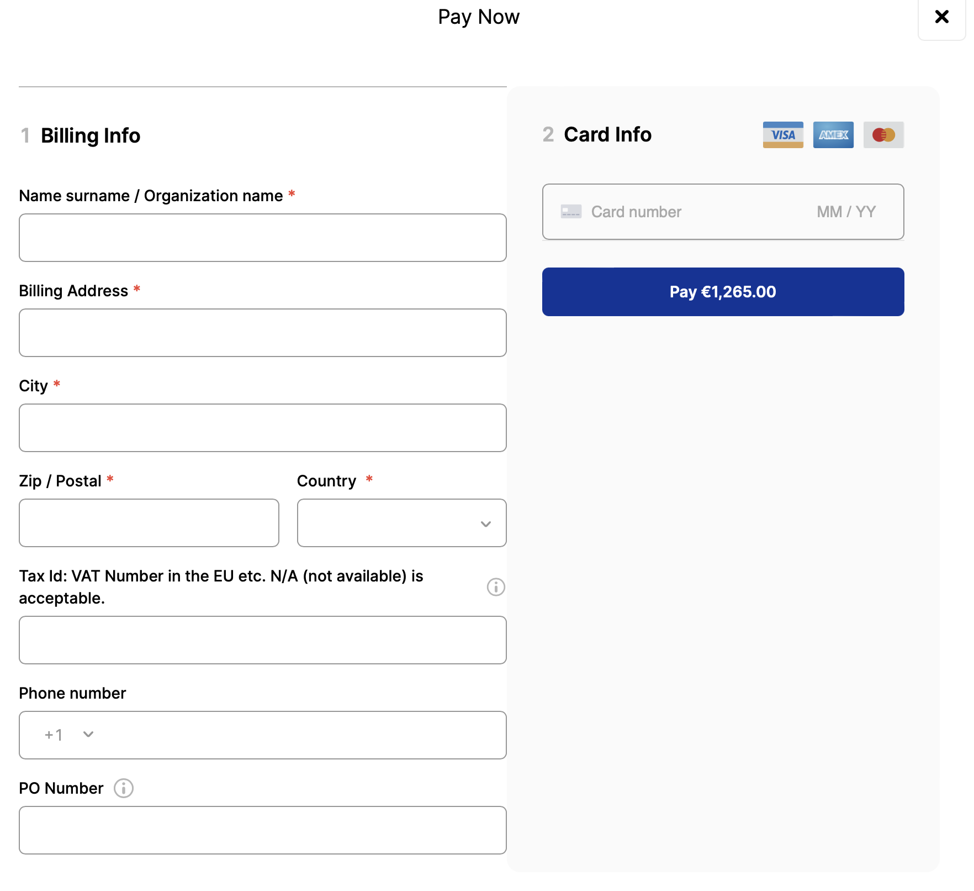
Time to check out - immediately
You have two options when checking out. You can pay immediately or choose “Book now and Pay Later”.
Pay immediately:
This is by creditcard just check the ”I agree…” box and ”Proceed to Checkout”.
Fill in the billing information and credit card number followe by “Pay”.
You can download your receipt when you have paid.

Slide 11
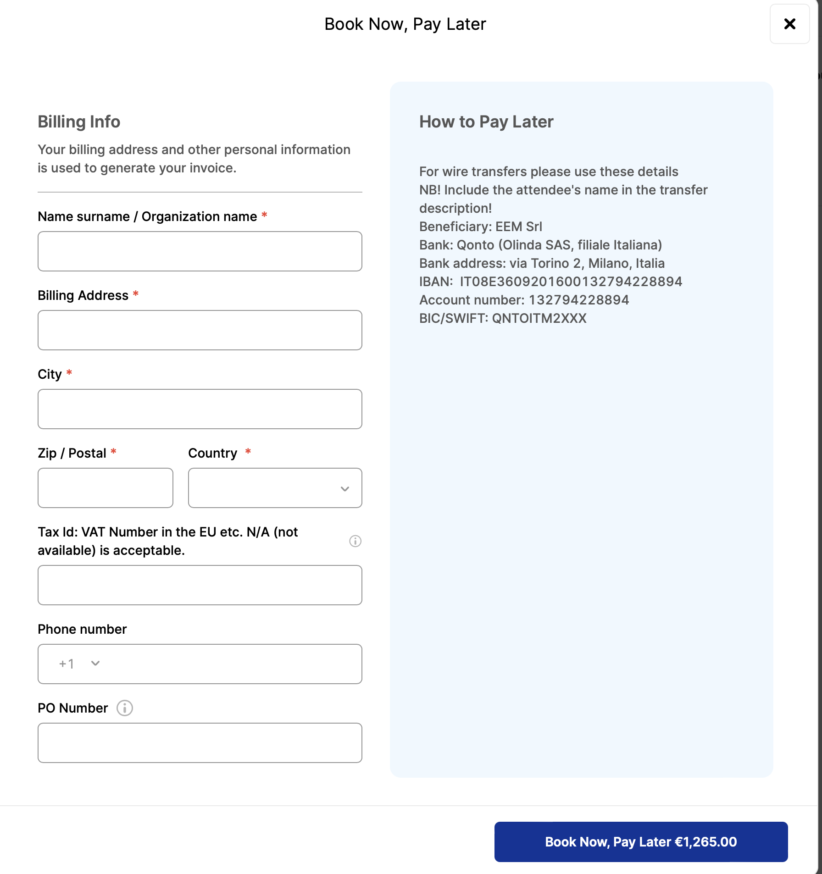
Time to check out – but pay later
Click on “Book Now, Pay Later” you will have to fill in the billing info as seen below. You can either log in to your registration area and pay by credit card, or make a wire transfer using the details under “How to pay later”.

Slide 12
Missing something?
Contact us at: gcom_imyos@eemservices.com

